Slide 1
LITA PROJECT
Visualizations of the sales Performance Analysis for a Retail Store

Slide 2
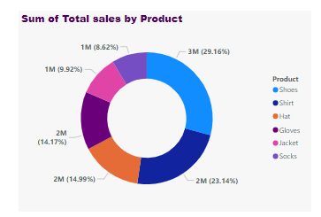
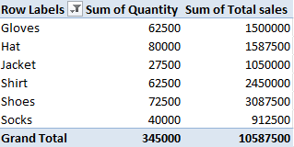
A pie chat representing the total sales of products and a table showing the quantity of sales

Slide 3
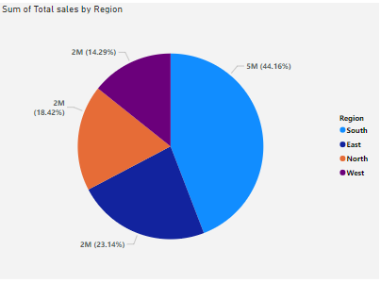
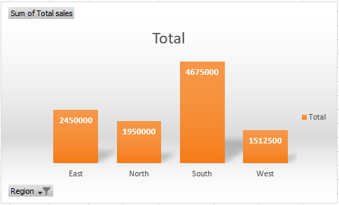
A pie and bar chat representing the total sales by region

Slide 4
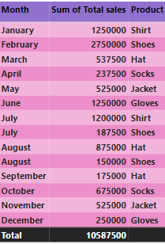
This is a table and a graph showing the total revenue for each month and what product was sold

Slide 5
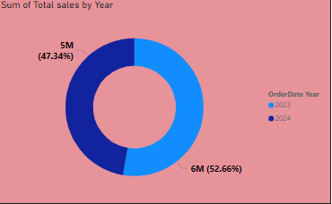
Pie chats representing the percentage of products sold in total and the total sales made in 2023 and 2024.

